Slide 1


Basics of Linux
Prasad Potluri
02/28/2012
Version-2.0

Slide 2
What is Linux ?
Linux is a name given to set of distributions of Operating System. Technically there is no Operating System called “Linux”.
Linux is designed in early 90’s by a Finnish student named Linus Torvalds, who wasn't too happy with Minix, the educational version of the UNIX operating system. (Linus Torvalds still leads the Linux Kernel Development to-date).
Linux is a Open Source Kernel that is used by many Linux Distributors to make their own version of “Linux”.

Slide 3
Various Linux Distros…
Red Hat Enterprise Linux (RHEL)
Oracle Enterprise Linux (OEL)
Ubuntu
SUSE Enterprise Linux
Mandriva
CentOS based on Red Hat Enterprise Linux
Sabayon
Slackware
Gentoo
FreeBSD (Berkley Software Distribution, and Mac OSX is based off of BSD)

Slide 4
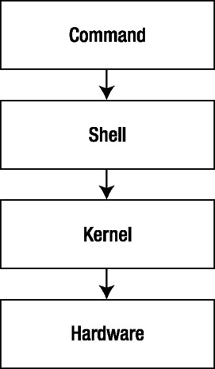
What is a Shell ?
The shell is a command-line interpreter that lets you access some of the most critical Linux tools.
Shell is a interpreter between what a user enters in the command line to the kernel of the operating system. Kernel also acts a interpreter between user and hardware.

Slide 5
Types of Shells Part: 1
SH: Bourne Shell, designed in 1977 by Stephen Bourne. This shell lacked a lot of features such as command line history and job control which were there by default in C (C programming language) shell.
CSH: C Shell, designed in 1978 by a berkley student allowed users to even execute their C programming language written scripts. This shell had a huge popularity till the late 90’s because the kernels in UNIX and LINUX are written using C programming language.
KSH: Korn Shell, designed by David Korn to be a middle of road design for sh (Bourne Shell) and csh (C Shell). Korn shell is used till date as a default shell in UNIX operating systems such as AIX and HP-UX.

Slide 6
Types of Shells Part: 2
BASH: Bourne Again Shell, BASH is the most common used shell in Linux.
BASH is shipped as a default shell to most of the Linux Distros.
The name BASH is also descriptive of what it did, bashing together the features of sh, csh and ksh.
BASH is designed to run any scripts that are written in SH, KSH, and CSH.

Slide 7
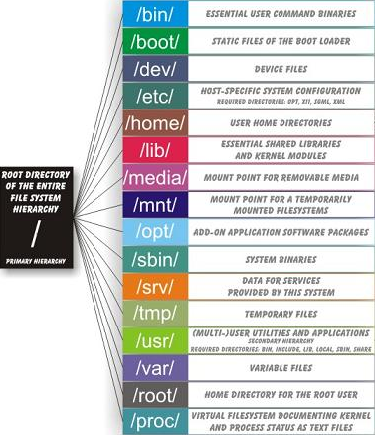
Linux Files and Directory Structure…
\\argos\Books\Linux_Directory_Reference.docx
Refer to the above link for more Information:

Slide 8
Linux & File Extensions…
File Extensions are used very commoly in windows world, for example “.doc”, “.xls”, “.ppt”, “.dll”, and etc…
In Linux there is no concept of File Extensions, because Linux refers to everything as either a human readable language file or a binary file.
There are file extensions in Linux although they only pertain to applications running on Linux

Slide 9
Common Linux File Extensions Part: 1
.bz2 | A file compressed using bzip2 .
.c | A file written in the C programming language.
.conf | A configuration file. In some cases, "conf" is used in a file name, but not as an extension.
.lock | A lock file that prevents the use of another file.
.rpm | A Red Hat package file.
.so | A shared object (a library or module).
.tar | A single file made of a collection of files archived using the tar command.
.tar.gz | A single file made of a collection of files archived using the tar command, then compressed used the gzip command.
.tgz | A single file made of a collection of files archived using the tar command, then compressed used the gzip command.
.gz | A file compressed using the gzip command.
.txt | a plain ASCII text file
.ps | a PostScript file; formatted for printing

Slide 10
Common Linux File Extensions Part: 2
.au | an audio file
.wav | an audio file
.xpm | an image file
.jpg | a graphical or image file, such as a photo or artwork
.gif | a graphical or image file
.pdf | an electronic image of a document
.a | an archive file
.h | a C or C++ program language header file
.cpp | a C++ program language source code file
.o | a program object file
.php | a PHP Script
.sh | a Shell Script
.png | a graphical or image file
.tcl | a TCL script
.pl | a Perl script
.html | an HTML file

Slide 11
Red Hat Enterprise Linux Versions
RHEL is shipped in various releases.
5.X (5 is the version, X is the release)
The latest release of RHEL is 6.2 and the most common versions used are:
5.4
5.5
5.6
5.7
5.8 (latest release in version 5)
6.1
7.0
7.x

Slide 12
Red Hat Installation Methods
Install from CDROM
Install from Red Hat Satellite Server
Install from Custom PXE/DHCP/NFS/Kickstart/TFTP setup.
Install from ISO using HP ILO Virtual Media
Install to/Boot from Local Disk
Install to/Boot from USB
Install to/Boot from SAN

Slide 13
Red Hat Installation
Install from Satellite Server
Configure NetApp
How to use HP Onboard Administrator.
How to use HP ILO
How to configure Boot From SAN.
How to PXE Boot
Post Installation Steps
eXbYlxZZ
e: enclosure
X: Enclosure # (5)
b: blade
Y: Blade # in the enclosure
lx: Linux
ZZ: Blade # out of the total number of blades (80)

Slide 14
Install from Satellite Server
When you install Microsoft Windows products one of the required steps is to activate the Windows product to Microsoft.
When you install a Red Hat Enterprise Linux product you will have to Register the server (Post-Install) to the Red Hat Network as a part of the Registration Process.
RHEL is not free (technically its free). The Operating System is free but you are charged around $3000 a year for the delivery of support and patches and as a surprising news… Windows Server 2008 R2 is cheaper than Red Hat Enterprise Linux. If you are looking for a open source alternative with no support you may use CentOS.

Slide 15
Install from Satellite Server
To register a RHEL server to Red Hat Network what is the minimum access you would need ?
You must have a RHN Account
You must have purchased an entitlement (licenses) for your RHEL server.
You must have WAN access to your RHEL server during the registration process.
To install patches or download new packages your RHEL server must have access to the RHN.

Slide 16
Install from Satellite Server
Satellite Server acts as a middle layer between your RHEL Server and RHN.
Satellite Server is installed in a server (Physical/Virtual) in your LAN.
Satellite Server downloads the configured RHN channel (The entire RHN is over 20TB).
What is a channel ?
A channel consists of all the packages for a Red Hat Enterprise Version (5/6) and Architecture (x86_64).
A channel also consists of all the releases based on the version
For example: A channel for Version 5 will contain all the releases of 5 and also the updates and patches.

Slide 17
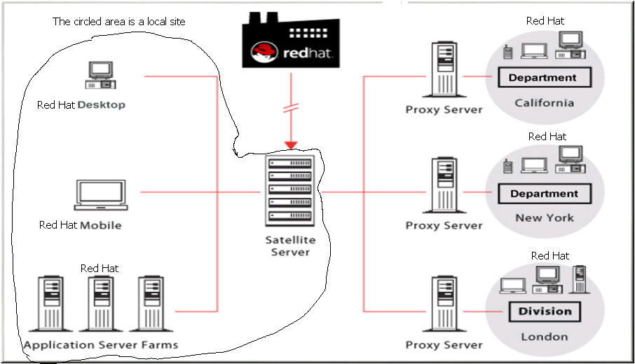
Install from Satellite Server
The entire environment below other than RHN is interconnected via VPN.

Slide 18
Install from Satellite Server
To install from the Satellite Server you will need to configure/use a existing DHCP server.
The DHCP server will assign an IP address to the Host that is booting using the PXE (Pre-Execution Boot Environment).
PXE is very old designed in the mid nineties and it has not been updated to add features such as assigning static IP. So a DHCP server is required to assign an IP Address while PXE booting.

Slide 19
Install from Satellite Server
Watch the following video to configure dhcp in windows. \\argos\labwork\videos\linux\Configuring Windows DHCP - Satellite.html
Configure the following options in DHCP Scope → Scope Options in Microsoft Windows:
60: PXEClient and String Value is “Support”
66: Boot Server Host Name and String Value is “IP_ADDRESS_OF_SATELLITE”
67: Bootfile Name and String Value is pxelinux.0

Slide 20
Install from Satellite Server
Kickstart profile needs to be created
Kickstart profile identifies which Operating System, Version, Release, Language, Installation Options, Packages, Volume Configuration, Root Password, Firewall (Enabled/Disabled), and SELinux.
Activation Key: Activation Key is required by any new or existing RHEL server to Join the Satellite Server.
Activation Key will allow the RHEL server to Join and also will add it to a group of servers and define the Default base channel

Slide 21
Install from Satellite Server
System Groups and Default Base Channel.
System Groups are nothing but a group of Systems.
Default Base Channel is the Channel the RHEL server is assigned to…
When you patch your RHEL server or install a package, the patch and the package are searched in the Default Base Channel.

Slide 22
Install from Satellite Server
Summary to Configure Satellite Server
Create a System Group
Create a Activation Key, Define Default Base Channel and Add/Join the Group
Create a Kickstart profile and Define the Activation Key in the Kickstart profile.
*Note* In the last class every body missed the step on defining the activation key in the kickstart profile. Select the Activation key in your kickstart profile and click on “Update Activation Key” or else it will not attach your Activation key to the Kickstart Profile.

Slide 23
Configure NetApp
 | Connected to FC Switch A
 | Connected to FC Switch B
B | Disk Array | Enclosure | FC Port A
A | 14 x 144GB | 10K RPM | FC Port B
B | Disk Array | Enclosure | FC Port A
C | 14 x 144GB | 10K RPM | FC Port B
C | Disk Array | Enclosure | FC Port A
A | 14 x 144GB | 10K RPM | FC Port B
 | NetApp | Filer
FC Port A | FC Port B | FC Port C | FC Port D
4 gbps | 4 gbps | 4 gbps | 4 gbps
FC Switch | A | FC Switch | B
Notes:
NetApp Filer: A NetApp Filer is your storage processor, it receives requests for data from the servers that are attached to via a FC switch .
The filer contains no disks, except a CPU, Memory, Network, and FC interfaces
DAE: 14 x 3 x 144GB = 6TB RAW SPACE
RAID DAE: Double Parity
Total Amount of Space = 12 x 3 x 144GB = 5TB Available Usage Space

Slide 24

Configure NetApp
Download NetApp OnCommand Manager from \\argos\labvideos\sysmgr-setup-2-0R1-win.exe
Install NetApp OnCommand Manager
Configure NetApp OnCommand Manager with the HostName "netapp"
username: root --- password: rootusa1
Click on Volumes
Click on Create inside the Volumes tab
Define the Volume name as “eXbYlxZZ_vol01” and the storage type is SAN.
Total Size = 50GB
Snap Shot Reserve 0 %
Click on “Thin Provisioned” and Click Create
Click on LUNs, click on Create, Click Next
Type in the Name of the LUN: “eXbYlxZZ_bootlun”, select “linux” O.S. Type
Configure size at 20GB and check the “Thin Provision” box

Slide 25
Configure NetApp
Click Next, Select an existing volume or qtree for this LUN.
Click browse, find and select your respective volume and click next
You will need the WWPN to create a initiator group.
To find your WWPN for both FC ports on your blade please click on the below video.
“\\argos\labwork\videos\linux\Configuring LUN - WWPN - Onboard Administrator.htm”
Select the initiator group and click next and finish.
yum.log
Notes:
Initiator Group: Initiator Groups are created, so that a LUN that is creating the SAN can be provided access to a server/servers. The advantage of Initiator Groups are that they provide security to the data and also the LUN is dedicated to a server or servers.

Slide 26
ls –l /
Command Flag argument
ls –ltr /
The above command will print the output of folder / in long list format, sorted by time and recursive.

Slide 27
cd command is used to change directory
cd /
cd command used alone will take you back to your home directory
cd – (will take you back to the previous working directory)
You have a directory structure as follows : /root/.gconfd/apps
Your pwd reports .gconfd
what is the parent directory for .gconfd ?
/root [..]
what is the current directory for .gconfd ?
/root/.gconfd [.]
what is the sub directory/child directory for .gconfd ?
/root/.gconfd/apps

Slide 28
Nslookup: can be used in dos or linux, the command is used to look up an ip address of a dns entry.
Setup: This command is used to configure your server.
IP Address, DNS, Gateway and Hostname
cat /etc/issue --> This command will display the current version and type of linux.
cat /etc/redhat-release --> Verify similar to the output of /etc/issue
dmidecode --> Prints all the servers hardware information.
“dmidecode | grep Product” → Prints the Product Model and Blade Info
ifdown: if in ifdown means Interface and down means to disable the network adapter.
vlan 0 :- eth0 and eth1
vlan 10 :- eth2 and eth3
ifdown ethX
Notes:
uname –a : The kernel version can be retrieved using the uname –a command.

Slide 29
ifup: if in ifup means interface and up means to
enable the network adapter
ifup ethX
Uptime: Displays how long the system is up and running
, the current system time, system status, the duration server has been in up status, # of users logged in, cpu usage.
ethtool ethX
Supported link modes: 10000baseT/Full (10 Gbe)
Speed: 1000Mb/s
Link detected: yes
What is incorrect in the above scenario ?

Slide 30
ls: Lists all files in a folder
ls –l (Displays folder structure in a long list format)
-rw-------1rootroot901Sep 24 16:47 anaconda-ks.cfg
Permissions of the File
# of inodes
Owner of the file
Group Owner of the file
File size in bytes
Date last modified
Filename
ls –a (Hidden files in the folder, A file in linux can be hidden by putting a “.” In front of the filename)
ls –t (Sort by time)
ls –r (Recursive/Reverse)

Slide 31
Inode
inode is a very simple concept, the concept is that every file has a file.
All inodes are stored in the superblock of the file system and cannot be accessed by a admin.
All inodes are 4KB by default and store the following attributes “stat FILENAME”:
File: `install.log'
Size: 25629 Blocks: 64 IO Block: 4096 regular file
Device: 6802h/26626d Inode: 327682 Links: 1
Access: (0644/-rw-r--r--) Uid: ( 0/ root) Gid: ( 0/ root)
Access: 2011-09-25 14:50:41.000000000 -0400
Modify: 2011-09-24 16:47:26.000000000 -0400
Change: 2011-09-24 16:47:29.000000000 -0400
If a inode is gone and a file ends up in lost+found, the file is considered orphaned. If a file is gone the inode is also considered orphaned and ends up in lost+found.

Slide 32
touch command creates a blank file.
touch FILENAME → creates a blank file, and can also be used to test the status of the boot from san. (read-only means bad)
date command prints the current date & time on your server
date +%H:%M → will print date in a hour:minute format.
cp command is used to copy a file
cp ORIGFILE NEWFILE → will copy the file and paste it to a location of your choice, if you do not specify a location it will copy to the same folder.
cp –p (the –p flag is used to preserve attributes such as time stamp)
cp –r (the –r flag is used to copy folders or recursively copy every single file from folder)
You can also use cp –pr to copy the entire folder and to another folder and maintain/save the attributes of all the files in the orig folder.
mv command is used to move a file or rename a file. The move command is also similar to cut and paste in windows. The move command can cut, paste, and rename at the same time.

Slide 33
history command is used to print past historical commands and the history information is stored in /root/.bash_history
history # → the # can be replaced with a number which will the last # of commands.
history –c → the –c flag will clear the history (DON’T DO THIS YOU WILL BREAK AUDITING POLICIES IN MAJOR CORPORATIONS AND COULD GET YOU IN TROUBLE)
pwd command is used to find out your Present Working Directory (PWD)
rm command is used to remove a file
rm –r (remove folders recursively)
rm –f (Remove with Force)
ln command is used to link a file or shortcut
ln –s (Creates a shortcut ln -s /root/install.log /root/install.log.shortcut)
unlink command is used to delete or break a shortcut
unlink/root/install.log.shortcut

Slide 34
mkdir command is used to create a directory
mkdir /root/1
mkdir –p (this flag is used to create the missing parent directories)
mkdir /root/1/2/3/4/5/6
Will the above work ?
mkdir –p /root/1/2/3/4/5/6
Will the above work ?

Slide 35
wc command is used to count number of lines, words and characters.
wc –c (Characters only)
wc –l (Lines only)
wc –w (Words only)
wc (Lines, Words, Characters)
du (disk usage) command is used to display size of an entire folder
du –sh (Display the entire folder size and displays it in human readable format)
-k
-m
-h

Slide 36
chown command is used to change ownership (user & group) of a file.
touch file1 file2 file3
chown games:games file1 (changes both owner and group)
chown root file1 (changes only owner)
chgrp root file1 (changes only group)
chown –R (have to use upper case R to modify the entire folder)
chmod command is used to change file permissions of a file.
chmod –R (have to use upper case R to modify the entire folder or recursively changes all the files and folders when u use this flag against a folder)

Slide 37
R | W | X
Read only | Modify & Delete | Execute allows you to run the program/application
r | 4
w | 2
x | 1
no perm | 0
owner | 4 | r
group owner | 2 | w
others | 5 | r-x
Notes:
Owner: The owner of the file/folder which can be modified using chown command
Group Owner: The Group that owns the file/folder which can be modified using chgrp command.
Others: Any one else other than Owner or Group that owns the file/folder.

Slide 38
cat command is used to view the contents of a file
cat filename
head command displays the first 10 lines
head -15 (displays the first 15 lines)
tail commands displays the last 10 lines
tail -15 (displays the last 15 lines)
tail -f (follows a file will not MODIFY anything in the space, and it allows you to view any changes made to the file. VERY IMPORTANT WENT TRACKING LOGS IN LINUX)
tail –f /var/log/secure (open another ssh window and login)
find command is used to find files and folders
find / (location to search) –name (search by name) FILENAME/FOLDERNAME&WILDCARDS
find / -size +10M
More info: http://www.cyberciti.biz/faq/find-large-files-linux/

Slide 39
vi editor:
Edit Mode | shift + g → EOF (End of File)
i→ insert | shift + 4 ($) → EOL (End of Line)
u→ undo | yy→ Copy a line where your cursor is at:
. →redo | p → paste the line that you have copied.
a→ append | d$ → delete till end of line from cursor
x→ Delete | dd→ delete line
 | dw→ delete word
Nyy→ Replace N with the number of Lines. This will copy the number of lines including your current line.

Slide 40
Command Mode
/ → Search for where your cursor is at for a string in your vi editor
? → Reverse Search for where your cursor is at for a string in your vi editor
: → command mode
w→ write means to save to a file and not “insert”
q →quit
q! →force quit with out saving
wq! →write and force quit
:%s/ORIGINAL/REPLACEMENT
:%s/WORD1/WORD2

Slide 41
Exercise:
echo "I store all my scripts in /usr/local/scripts"
echo "I store all my personal files in /home/prasad/files“
SED → Search and Replace
cat sedexample.sh
/usr/local/scripts/today
sed -i 's/\/usr\/local\/scripts\/today/\/root\/scripts/g' sedexample.sh
cat sedexample.sh
/root/scripts
SED will replace everything that is WORD1 with WORD2.
Using VI editor replace the following:
store --> save
/usr/local/scripts --> /home/prasad/scripts
Using sed command replace the following:
personal --> non sensitive
/home/prasad/files --> /tmp/files

Slide 42
tar command is used to compress a file(s) or folder(s) in to a tar ball.
-c → Compress
-x → Extract
-t → View/Test
-v → Verbose
-f → File
-z → Compress using gzip algorithm.
tar –czvf tarfile.tar.gz file(s)/folders(s)→ Compress
tar –tzvf tarfile.tar.gz→ View files/folders inside tar file
tar –xzvf tarfile.tar.gz→ Extract tar file

Slide 43
User and Group Administration
/etc/passwd: This file is where all the users and the default shell assigned to a user is stored.
Entries in /etc/passwd are as follows:
root:x:0:0:root:/root:/bin/bash
The user account or the username
The password which is encrypted and now stored in /etc/shadow
The uid or the userid this is a numeric number which defines the userid or uid
The gid or the groupid this is a numeric number which defines which group or gid the user belongs to.
The group which the user belongs to by default or in linux its called primary group.
The home directory or the default directory for the user root
The default shell the user gets when he logs in.

Slide 44
/etc/group: This file is where all the groups and the information regarding the users belonging to groups is stored.
Entries in /etc/group are as follows:
root:x:0:root
Group Name
Whether the group is activate or deactivated
The group ID
The users who belong to the group

Slide 45
useradd: This command is used to add user in to linux (useradd –u (uid) NUM –g GROUPNAME username)
groupadd: This command is used to add groups in to linux (groupadd -g GID groupname)
passwd: This command is used to change the current user password.
usermod: This command is used to modify attributes of a user (usermod –G group1,group2,group3, group4 user)
groupmod: This command is used to modify attributes of a group
userdel: This command is used to delete a user
groupdel: This command is used to delete a group

Slide 46
Environmental Variables, Standard Input, Output and Pipes
Variable: A variable has a value.
env: This command displays all the environmental variables for your shell in Linux.
set: Very similar to env displays all your system/kernel environmental variables
echo: Displays the value of the variable.
export: This command is used to create any new environmental variables.
→ variables can be set without export but if you set a variable without export the variable will only be local (shell) and with export command the variable is global and will last till the system or os reboots.
unset: Removes a environmental Variable in memory.
PATH variable stores information regarding directories where all your commands reside for your shell.
Notes:
If you would like to make the environmental variable permanent, add an entry in /etc/profile for ex: “VAR = VALUE”
which command searches the path variable, and displays which folder your command is executing from. So you don’t have to type /bin/ls all you have to do is type ls.

Slide 47
Standard Input and Output: Both Standard output and Input are used to redirect
Standard Input is to redirect an input to a file or a command. >
cat emailmessage
Hello from Linux
If you can read this I am contacting from the Death Star in Star Wars. Darth Vader is a really cool Guy.
Prasad Out
mail -s "Hello from Linux" ppotluri@vmpro.com < emailmessage
Standard input is used to redirect an output from a file or command. <
echo 100 > numbers
echo 200 >> numbers
Pipe is to redirect the output as an input to another command (Its stdin and stdout together).
Pipe is used when you want to pass the output from a command to another command in memory, unlike standard output the output is passed to the storage
Notes:
Standard Output (ls > ls.txt)
The output from ls command is sent to ls.txt
< Standard Input (mail < message)
The output from message is sent as input to mail.

Slide 48
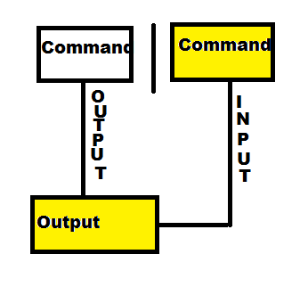
Resource Monitoring:
Processes: Task Manager
CPU: Task Manager
MEMORY: Task Manager – Performance Tab
I/O (Disk): Task Manager -- Performance Tab -- Resource Monitor (Only Available Win 7)
NETWORK: Task Manager – Networking

Slide 49
Processes: ps –ef
UID PID PPID C STIME TTY TIME CMD
UID: User ID or Username the process is running under.
PID: Process ID for the process
PPID: Parent Process ID
C: Priority of the process (-19 to 19)
STIME: Start Time of the process
TTY: if it’s a ?then its running on the local server, if it has a TTY entry then its running on a shell.
CMD: The actual command or process or script
Notes:
-19 to 19: The lower the priority value the higher the priority
The higher the priority value the lower the priority.

Slide 50
CPU: top, vmstat, sar
*ANY OF THE BELOW COMMANDS USE “* -d X –c Y” X = # OF SECONDS and Y = # OF TIMES or COUNT”
top:
If you would like to view top information more frequently use “top –d X” X = # of seconds.
Hit the “1” key in top to view all the cpu’s and cpu resource utilization.
vmstat: vmstat is used to list and resource monitor CPU, Memory and I/O statistics in a server
Notes:
Zombie processes cannot be killed, the only way to stop a zombie is to reboot.

Slide 51
Procs | Procs
r b | r: The number of processes waiting for run time.
0 0 | b: The number of processes in uninterruptible sleep.
-----------memory---------- | Memory
swpd free buff cache | swpd: the amount of virtual memory used.
0 15911940 87152 281252 | free: the amount of idle memory in kilobytes
 | buff: the amount of memory used as buffers or any data written to disk is first written here then written to the storage to act as a buffer
 | cache: the amount of memory used as cache or the amount of memory used to store the most commonly accessed files. This cache really helps because the CPU can get the files from memory than from storage. If the data on the file changes in memory it is immediately sent to the buffer. When a kernel detects a inode being constantly accessed (read) it copies the file from the storage space in to memory space for fast access.

Slide 52
Procs | Procs
 | inact: the amount of inactive memory. (-a option)
 | active: the amount of active memory. (-a option)
---swap-- | Swap
si so | si: Amount of memory swapped in from disk (/s).
0 0 | so: Amount of memory swapped out to disk (/s).

Slide 53
Procs | Procs
---io--- | IO
bi bo | bi: Blocks received from a block device (blocks/s).
0 0 | bo: Blocks sent to a block device (blocks/s).
--system-- | System
in cs | in: The number of interrupts per second, including the clock.
7 7 | cs: The number of context switches per second.
-----cpu------ | CPU
us sy id wa st | These are percentages of total CPU time.
0 0 100 0 0 | us: Time spent running non-kernel code. (user time, including nice time)
 | sy: Time spent running kernel code. (system time)
 | id: Time spent idle.
 | wa: Time spent waiting for IO.
 | st: Startup Defaults

Slide 54
MEMORY: vmstat, free –m
Free: This command is used to display the free memory on your Linux servers you can use the –k (KB), -m (MB), -g (GB)
I/O (Disk): iostat (each blk = 4KB)
Device: Which Device ?
tps: Transaction per second.
Blk_read/s: Blocks read per second
Blk_wrtn/s: Blocks written per second
Blk_read: Blocks read in total since the server is up
Blk_wrtn: Blocks written in total since the server is up
Notes:
Memory Priority:
Applications/Kernel
Buffers
Cache

Slide 55
*BY DEFAULT IOSTAT IS NOT AVAILABLE IN LINUX, YOU HAVE TO INSTALL sysstat*
Iostat: This command is used to display I/O statistics or Read and Write blocks per sec.
NETWORK: netstat–in
Netstat –in: This command is used to display
Network/Interface Statistics in RX (Receive) and TX (Transmit)
netstat -tnlp: This command with tnlp flags prints just the listen ports so you can see the command pre service start and post service start.
watch: This command is used to a task repeatedly in a terminal session window every 2.0 secs by default. (watch vmstat)

Slide 56
Disks and Filesystems
Windows Partition example:
Add a new hard drive in your computer (possibly from best buy)
Bring the disk online
Initialize the Disk (assists windows to understand the type of disk and the size of disk)
Partition the drive (Allows you to allocate a part of the disk to Windows)
Assign a drive letter (Assigning drive letter allows a user to store files easily)
Format the Partition with NTFS (Will allow windows to manage the Filesystem and Journal)
Video: "\\argos\labvideos\Videos\Linux\Basics of Linux\Windows-Partition-Example.html“
df: This command prints the Disk/Partition Free space that is mounted on your linux system.
-k (kb) –m (mb) –h (human readable)
mount: This command prints all the mounted file systems in your linux server.
LVM: Logical Volume Management

Slide 57
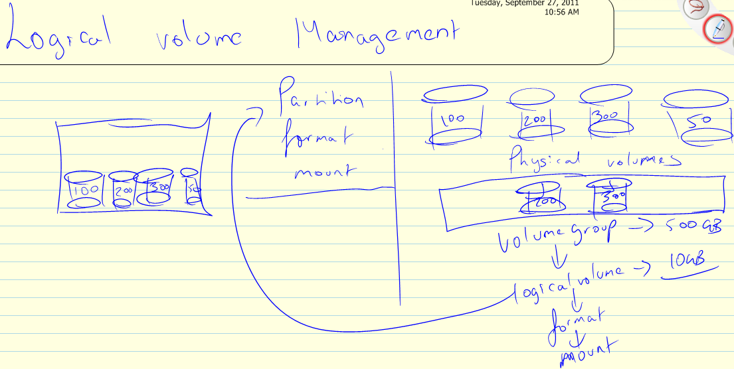

Slide 58
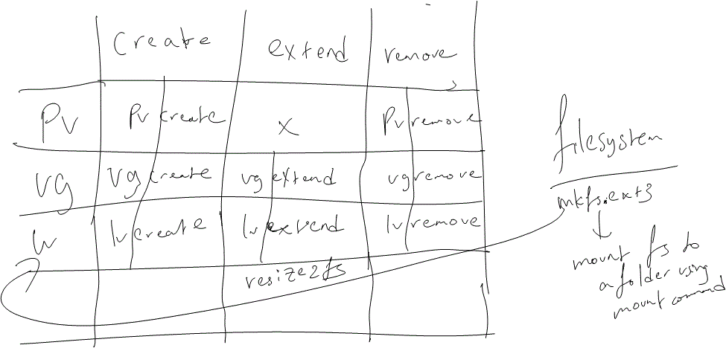

Slide 59
1) fdisk /dev/mapper/ALIASNAME | 14) enter
2) u --> convert cylinders to sectors | 15) q --> quit
3) enter | 16) pv
4) n --> new partition | 17) vg
5) enter | 18) lv
6) p --> primary partition | 19) mkfs.ext3
7) enter | 20) resize2fs
8) 1024 --> leave 1 MB of data | 21) /etc/fstab
9) behind | 22) /dev/vg10/lvol1
10) enter | 23) /firstfs ext3 defaults 0 0
11) enter | 24) fsck: Filesystem Check, checks for any corruption or bad inodes on your filesystem. The command is fsck –fy(-f = force, -y = auto yes). FSCK SHOULD ONLY BE RAN ON AN UNMOUNTED FILESYSTEM.
12) w --> write changes to the
13) partition table

Slide 60
pvcreate /dev/cciss/c0d0p4 | umount /firstfs
vgcreate vg10 /dev/cciss/c0d0p4 | rm -rf /firstfs
lvcreate -l 100%FREE --name=lvol1 vg10 | lvremove -f /dev/vg10/lvol1
mkfs.ext3 /dev/vg10/lvol1 | vgremove vg10
mkdir /firstfs | pvremove /dev/cciss/c0d0p4
mount /dev/vg10/lvol1 /firstfs
df -h

Slide 61
/etc/fstab
Device | Mount Point | FS Type | Mount Point Options | Mount Order | Mount Verification
/dev/DBVG/lvol0 | /opt/oracledb | ext3 | defaults | 1 | 1
 |  |  |  | Lower the number the higher the priority | Mount Verification Set it to 0 if you want to ignore the mount verification.
The Mount Verification will allow the OS to boot only if the mount actually happens.
If the mount fails due to the device or san issues the OS will enter a maintenance mode (safe mode) and you will have to resolve the issue and reboot the O/S from maintenance mode Homework: put a bad entry (any characters or words that make no sense at the end in /etc/fstab) If your server is in maintenance mode, login, run “mount –o remount,rw /” and then vi /etc/fstab and remove the bad entry. Save and Force Quit and reboot the server.

Slide 62
Grep command: Grep command is used to search contents in a file by string
grep –i (-i flag means ignore case)
nice: Nice command assigns a priority to a process before it begins.
Priorities in Linux range from: -19 to 19… The lower the priority number the higher the CPU priority.
nice –n “PRI” command
time nice -n -19 tar -cvf usrbackup.tar /usr
renice: Renice commands assigns a priority to a process while its running.
renice –“PRI” PID
ifconfig: Interface Configuration, prints the ip address of the Linux Network Interfaces.
ifconfig –a (-a = all interfaces)

Slide 63
Link encapsulation | Type of Network
Hwaddr | MAC Address of the NIC PORT
inetaddr: | IP Address of the Interface
Bcast (Broadcast) | Broadcast address of Interface
UP BROADCAST RUNNING MULTICAST | Connection is UP Connection is Broadcasting Connection is RUNNING Connection can also Multicast for monitoring
MTU | Maximum Transmission Unit
RX Packets | Receive Packets, or the # of Packets received
TX Packets | Transmit Packets, or the # of Packets sent
RX Bytes | Receive Bytes, or the # of Bytes Received
TX Bytes | Transmit Bytes, or the # of Bytes Transmitted

Slide 64
Diff: Diff command is used to check for differences between the content of two files.
Diff file1 file2
[root@c1b14lx14 ~]# cat file1 | [root@c1b14lx14 ~]# cat file2 | [root@c1b14lx14 ~]# diff file1 file2
1 | 3 | 1,2d0
2 | 4 | < 1
3 | 5 | < 2
4 | 6 | 5a4,5
5 | 7 | > 6
 |  | > 7

Slide 65
bc: Calculator
w: w displays all the users that are currently logged in
whoami: whoami displays the user account which you are logged in as…
last: last displays the last users that were logged in to your server
kill: Kill command is used to destroy a process for example “kill PID” or “kill -9 PID”. -9 is a SIGKILL to the CPU which means instant kill.
ssh: ssh is used to Remotely login from one server to another.
ssh hostname
scp: secure copy is used to transfer a file from one server to another
scp localfile hostname:/remotedir/remotefile
scp /root/usrbackup.tar c1b1lx1:/root/usrbackup.tar
-p and -r can be used here just like cp command.
sort: sort command is used to sort an output or the contents of file.

Slide 66
# cat file1 | # sort file1
5 | 1
3 | 2
4 | 3
2 | 4
1 | 5
e | a
c | b
d | c
a | d
b | e

Slide 67
cal: Prints the calendar of this month
cal 1752 -- sep
&&: If you place && after command 1 and type in a command 2, the post event will be that command 1 will execute if command is successful with no errors it will continue and run command 2.
; : very similar to && but it will run command 2 regardless whether command 1 error’ed out or not.
nohup: nohup command is used to run a command or task post exit or when you close your putty if you have nohup in front of the command such as tar, the command will continue to run till it completes.
Example: rm –rf usrbackup.tar
nohup tar –cvf usrbackup.tar / &
exit

Slide 68
yum: yum command is used to install/upgrade packages or software on your linux server.
Example: yum install PACKAGENAM
yum install firefox
login to remote console and run firefox.
If you want to see all the packages available through yum “yum list”
yum groupinstall “X Window System”
startx
yum remove firefox
yum groupremove "X Window System"

Slide 69
wget: Is a text based download utility or command, its objective is the ability to download from the internet.
rpm -ivh webmin-1.560-1.noarch.rpm
rpm -qa | grepwebmin
rpm -e webmin-1.560-1
webmin: in a nutshell it is nothing but a Web Interface to administer linux.
RPM: Red Hat Package Manager is a Red Hat based Installer Utility.
IF YOUR WEBMIN DOES NOT WORK RUN "service iptables stop" <-- stops firewall in linux.

Slide 70
rpm flags
 | I | install
 | U | Upgrade
 | E | erase
 | V | Verbose
 | H | hash
to install | rpm -ivh filename.rpm
to upgrade | rpm -Uvh filename.rpm
to erase | rpm -e rpmname
To view installed rpms | rpm -qa | | grep RPM

Slide 71
To view the change log of a RPM rpm –q webmin-1.560-1 --changelog and to view the rpm details PRE-INSTALL rpm –qpilwebmin-1.560-1.noarch.rpm
/proc filesystem: /proc filesystem is proc and it stores all the kernel runtime information in user readable language.
cat /proc/cpuinfo | more
The above command displays all the CPU information, including the number of processors and cores.
cat /proc/meminfo | more
The above command displays all the memory information, including total physical memory.

Slide 72
runlevel: Run Levels determine whether your system will be in rescue mode, maintenance mode or running normally with or without X
runlevel command display the current and post reboot runlevel.
Init command is used to change the run level on the fly but the runlevel is lost and goes back to default after a reboot.
vi /etc/inittab file needs to be modified to change the runlevel permanently and the changes will only take effect after a reboot
id:5:initdefault: (Replace 5 with 3)
init 5

Slide 73
Windows | Runlevel
Repair mode | 1
safe mode | 2
safe mode with networking | 3
safe mode with command prompt | 3
Disable VGA Driver | 4
Normal | 5
Linux
X = graphical session in Linux
Shutdown | 0
Single User (reset root password) | 1
Multi User with no networking | 2
Multi User with networking but no X | 3
Unused | 4
Multi User with networking with X | 5
Reboot | 6

Slide 74
How do you boot in to run level 1?
init 1
vi /etc/inittab
Bootloader (MBR, NTLDR) in linux is called Grub. Grub configuration file is in /etc/grub.conf.
Install flash adobe flash player
install swiff player
Open File with Mozilla Firefox

Slide 75
Boot to runlevel 1
Access remote console
Hit the arrow key (any) when you see the Red Hat Enterprise Linux Booting up.
Hit e to edit the grub entry
Arrow down to the kernel line and hit e again to edit the kernel line.
In the kernel grub window append a “1” and hit enter
Press b to boot in to run level 1

Slide 76
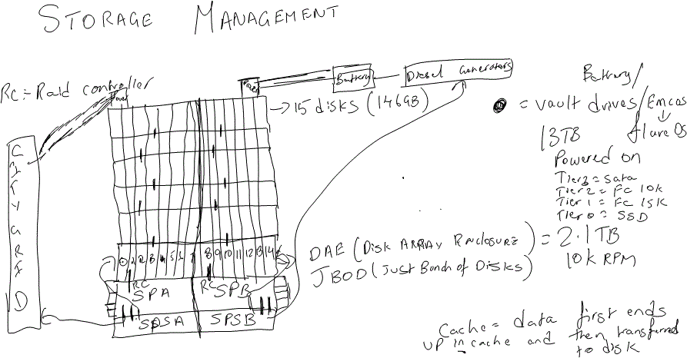

Slide 77
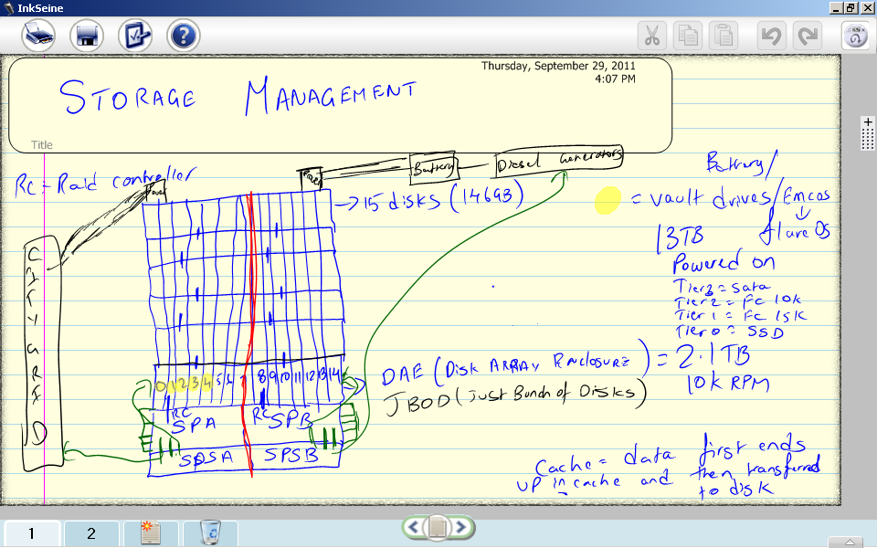

Slide 78
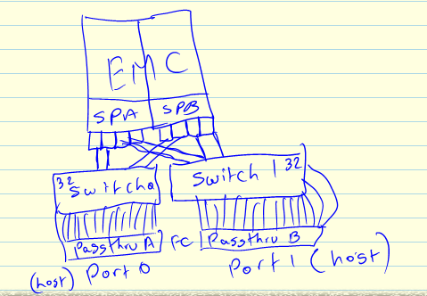

Slide 79
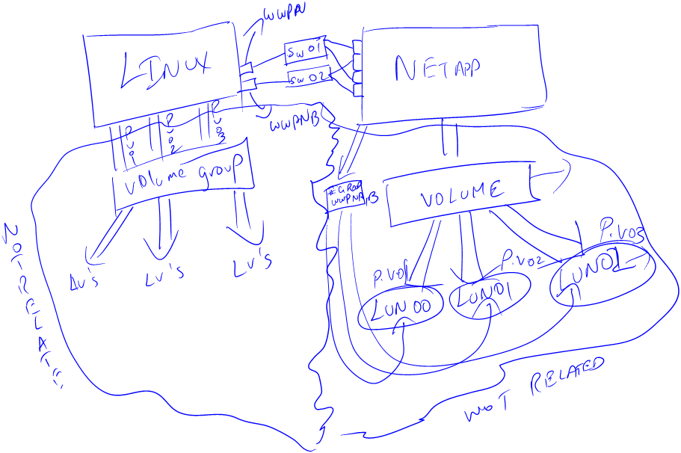
Storage Area Network

Slide 80
Multipath: Multipath allows you to take devices coming from multiple paths (2 PORTS to 2 FILER PORTS).
Multipath notifies the linux kernel multiple paths to a single storage device for ex: sdX and it will display the device with an alias instead of sdX (as sdX deems that its only using a single path)
Opensource: Multipath (multipath is a service, service name: multipathd)
PaidSource: EMC PowerPath, NetApp MPIO
/etc/multipath.conf and multipath –ll (list)

Slide 81
If you want to rescan for a new lun that you attached, configure multipath and then “echo 1 > /sys/class/fc_host/hostX/issue_lip”
services & chkconfig
service: the service can be used to start, stop and restart a service.
service servicename start (stop/restart)
Windows Services: A service is nothing but an application that runs in the background of the operating system. A Service can restarted, stopped, started, enabled and/or disabled. (services.msc)

Slide 82
Any custom applications (weblogic, websphere, databases, http server/webserver, backup agents, monitoring agents) running your server will always be created as services. One of the good things about using/creating services is that it enables you to start a service when a systems starts up.
chkconfig: the chkconfig command can be used to enable/disable a service during a system startup/reboot.
chkconfig --list (is used to list all services)
chkconfig servicename on (off to disable at reboot).
chkconfig sendmail --level X on
chkconfig network off (homework)
Reboot
Notes:
So in the post event of a crash and the server reboots, the application/applications automatically startup when the server reboots.

Slide 83
Remote console →chkconfig network on → service network start→ and test ssh in to your server from your laptop using putty
chkconfig --list
chkconfig SERVICENAME off
chkconfig SERVICENAME on
service SERVICENAME stop
service SERVICENAME start
service SERVICENAME restart
service SERVICENAME status

Slide 84
NFS (Network File System):
Network File System, is a UNIX/Linux/Windows based common file system and is used to share files/folders across a Network Path. It is based off of TCP/IP and NFS is also the name of the protocol.
NFS is file-based file system and NOT like a block-based file system (ext3, ntfs, jfs)
NFS is very similar to CIFS but NOT CIFS (Windows File sharing protocol, for example argos).
NFS is a service in linux (nfs).
NFS is based off of Server – Client Relationship.

Slide 85
mkdir /opt/backup
Edit /etc/exports and add the entry to share a folder on the NFS server
/opt/backup *(rw,no_root_squash) #The * means all hosts, rw means read and write permissions, no_root_squash means that client can have root permissions to the share folder
service nfs start (restart) (DO NOT RUN THIS AT WORK)
IF YOU NEED TO ADD ANOTHER SHARED FOLDER THAN THE ONE YOU ADDED PREVIOUSLY FOLLOW THE STEPS BELOW DO NOT RESTART THE NFS SERVICE. IF YOU RESTART/STOP NFS ALL CLIENTS WILL GET DISCONNECTED.
mkdir /opt/backup1
Add a second entry (/opt/backup1) to share a folder on the NFS server in /etc/exports and run “exportfs –a”
The exportfs command allows you to share the folders without restarting NFS daemon, if you restart NFS daemon constantly for every new addition of share you will cause the older shares to freeze. To get around this problem you run exportfs–a
mkdir /LOCALMOUNTPOINT
mount -t nfs SERVERNAME:/REMOTEMOUNTLOCATION /LOCALMOUNTPOINT
Notes:
Homework for the day: Figure out how to add NFS in to /etc/fstab so it automounts when the system reboots.

Slide 86
Bonding (Networking), traceroute
traceroute: traceroute command can be used to display hops from your server to the destination.
traceroute can also be used to resolve network issues such as switch issues and gateway issues.
Networking: /etc/hosts:
This file contains IP Address and Host Name for Local Name Resolution, it is better to put the IP Address and the hostname of the server you connect to the most because it avoids your server contacting DNS every time it has to contact the server that was supposed to be in /etc/hosts.
c:\Windows\System32\drivers\etc\hosts < -- WINDOWS

Slide 87
IPADDRESS FQDN ALIAS
10.10.3.100 sonicwall.vmpro.com sonicwall
FQDN = Fully Qualified Domain Name
/etc/resolv.conf: All the dns servers are entered in to the /etc/resolv.conf
This file is used to configure your name servers (ie: DNS Servers). The changes are LIVE no need to restart network.
search vmpro.com
nameserver 10.30.1.5
 | Networking in Linux
Physical |  | Virtual
You would need to setup redundancy or bonding |  | Virtual Redundancy is not required as the physical adapters are bonded by Vmware

Slide 88
/etc/sysconfig/network-scripts/ifcfg-ethX
DEVICE=ethX → Device Name
BOOTPROTO=none → BOOTPROTO = dhcp, static, none (none is preferred as you don’t pxe boot repeatedly)
HWADDR=MAC_ADDRESS → HWADDR = Hardware Address or Mac Address of the Interface
ONBOOT=yes → ONBOOT = yes or no (yes is preferred because it will not enable the adapter if it is set to no during BOOT).
NETMASK=255.0.0.0 → NETMASK = Subnet Mask of your network
IPADDR= IPADDRESS → IP ADDR = IP Address of the interface.
GATEWAY=10.10.3.100 → Gateway = Gateway address of the interface
TYPE=Ethernet

Slide 89
Network Settings | Filename
IP | cat /etc/sysconfig/network-scripts/ifcfg-ethX
SUBNET MASK | cat /etc/sysconfig/network-scripts/ifcfg-ethX
GATEWAY | cat /etc/sysconfig/network-scripts/ifcfg-ethX
DNS | cat /etc/resolv.conf
HOSTNAME | cat /etc/sysconfig/network

Slide 90
ethtool eth2 (Record the Link Detected Status)
ifconfig eth2 (Note that there is no IP)
vi /etc/sysconfig/network-scripts/ifcfg-eth2
Edit the following lines:
BOOTPROTO=dhcp (change to none)
ONBOOT=no (change to yes)
Add the following lines:
NETMASK=255.255.0.0
IPADDR=172.35.1.X

Slide 91
ifup eth2
ifconfig eth2 (Note now the new ip takes effect)
ethtool eth2 (Record the Link Detected Status)
ssh using the new ip of your clients address.
/etc/sysconfig/network
This file is used to configure the hostname for your linux server. (CHANGE AFFECTIVE INSTANTENOUSLY)
cat /proc/sys/kernel/hostname
/etc/nsswitch.conf
/etc/nsswitch.conf can be modified to ensure the system uses either /etc/hosts as primary/secondary and DNS (BIND) as primary/secondary.
hosts files dns

Slide 92
Bonding:
What are the four types of bonding?
Mode 1 – Mode 4
Either in /etc/modprobe.conf
/etc/sysconfig/network-scripts/ifcfg-bondX
MTU: Maximum Transmission Unit - 1490 - 1500
<1501 -- Multicast Broadcast Storm.
Mode 1 is Active / Standby
Mode 2 is XoR (Tx and Rx)
Mode 3 is broadcast (mostly used in UDP configurations)
Mode 4 it switches the MAC Address (Mac Address Spoofing) or also Active / Active.

Slide 93
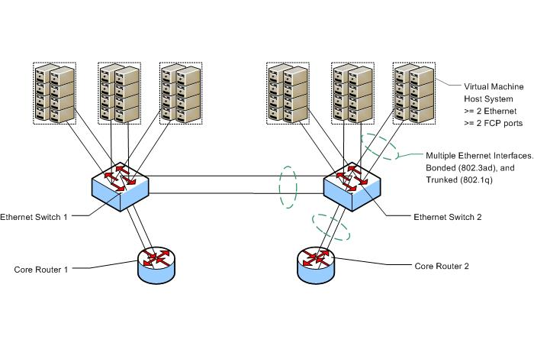

Slide 94
Configure Networking
WARNING: Beware of Baseboard Management Controllers (BMCs)
Baseboard Management Controllers (BMC) are increasingly shipped on rackmount servers. While these can be a great management tool, the versions that share the system's ethernet ports often don't react well with bonded interfaces. With the Broadcom NetXtreme II, you must disable the management firmware in order to enable bonding, less a broadcast storm occur on the connected switch. In the Broadcom case, a DOS utility "xdiag" is provided on the firmware update disk which can disable the management firmware (MF) code. If "xdiag -ver" shows "MF" active on a controller, you need to run "xdiag -c <controller#> -mfw 0" to disable it.

Slide 95
see: Network Switch Configuration- bonding and trunking With the switch configured, the VM host systems can now be configured. These steps are valid for all RHEL derivatives (Oracle EL, Oracle VM Server, CentOS, etc). All relevant files are in the /etc/sysconfig/network-scripts/ directory. Debian Linux and derivative (Ubuntu) users will want to look into the format of their distribution's /etc/network/interfaces file.

Slide 96
The end result is that the system will end up with a large group of interfaces: the physical interfaces (ethX: eth0, eth1, ...) bonding interfaces to aggregate the physical interfaces (bondX: bond0, bond1, ...) - also a VLAN trunk!. interfaces for each individual VLAN on the bonded trunk (bondX.vlan#: bond0.1, bond0.50) per-vlan bridges, these are the bridges that virtual machines will attach their native virtual interfaces (vifs) to, I have used the vlan# convention for the bridge names (vlan1, vlan50, vlan51...) where interface vlan50 participates in vlan ID 50 placed on the trunk.

Slide 97
Load Bonding Module
By default, the bonding module only supports the creation of one bonding interface. The "options bonding max_bonds=#" is used to increase this value to whatever # is required, which will generally be between 1 and 4 depending on your site and needs. Add the bonding module or Append the below lines to /etc/modprobe.conf alias bond0 bonding alias bond1 bonding options bonding max_bonds=2

Slide 98
Configure the bonding interface
bond0 via /etc/sysconfig/network-scripts/ifcfg-bond0
# 802.3ad bonded link
# switch po1: Gi1/1, Gi1/2
DEVICE=bond0
BOOTPROTO=none
ONBOOT=yes
BONDING_OPTS="mode=4 miimon=100"
IPADDR=IPADDR_SAME_AS_INTERFACE_ETH0
NETMASK=255.0.0.0
GATEWAY=10.10.3.100

Slide 99
Configure the physical interfaces (eth0 and eth1) that are part of bond0:
/etc/sysconfig/network-scripts/ifcfg-eth0
When you are done the the ifcfg-eth0 needs to look EXACTLY like below
# First interface in bond0 DEVICE=eth0 BOOTPROTO=static HWADDR=INTERFACE MAC ADDRESS TYPE=Ethernet ONBOOT=yes MASTER=bond0 SLAVE=yes

Slide 100
/etc/sysconfig/network-scripts/ifcfg-eth1
# Second interface in bond0
DEVICE=eth1
BOOTPROTO=static
HWADDR=INTERFACE MAC ADDRESS
TYPE=Ethernet
ONBOOT=yes
MASTER=bond0
SLAVE=yes

Slide 101
Configuration Complete once completed DO NOT “service network restart”, to activate the bond0 reboot the server.
A series of "ifup" commands will bring the above configuration into production without a reboot. Nevertheless, a reboot is strongly recommended to ensure that the network configuration restores itself properly

Slide 102
The following interfaces should be seen when running an "ifconfig": bond0 Link encap:EthernetHWaddr 00:14:5E:C0:FF:EE UP BROADCAST RUNNING MASTER MULTICAST MTU:1500 Metric:1 RX packets:33617546 errors:0 dropped:0 overruns:0 frame:0 TX packets:12192931 errors:0 dropped:0 overruns:0 carrier:0 collisions:0 txqueuelen:0 RX bytes:4023299390 (3.7 GiB) TX bytes:1022184796 (974.8 MiB) eth0 Link encap:EthernetHWaddr 00:14:5E:C0:FF:EE UP BROADCAST RUNNING SLAVE MULTICAST MTU:1500 Metric:1 RX packets:6783365 errors:0 dropped:0 overruns:0 frame:0 TX packets:2132508 errors:0 dropped:0 overruns:0 carrier:0 collisions:0 txqueuelen:1000 RX bytes:731753941 (697.8 MiB) TX bytes:226889202 (216.3 MiB) Interrupt:23 Memory:ce000000-ce011100 eth1 Link encap:EthernetHWaddr 00:14:5E:C0:FF:EE UP BROADCAST RUNNING SLAVE MULTICAST MTU:1500 Metric:1 RX packets:26834181 errors:0 dropped:0 overruns:0 frame:0 TX packets:10060423 errors:0 dropped:0 overruns:0 carrier:0 collisions:0 txqueuelen:1000 RX bytes:3291545449 (3.0 GiB) TX bytes:795295594 (758.4 MiB) Interrupt:16 Memory:ca000000-ca011100 lo Link encap:Local Loopback inet addr:127.0.0.1 Mask:255.0.0.0 UP LOOPBACK RUNNING MTU:16436 Metric:1 RX packets:59021 errors:0 dropped:0 overruns:0 frame:0 TX packets:59021 errors:0 dropped:0 overruns:0 carrier:0 collisions:0 txqueuelen:0 RX bytes:14567768 (13.8 MiB) TX bytes:14567768 (13.8 MiB)

Slide 103
The status of the bonded interface can be seen by using the procfs and sysfs:
/proc/net/bonding/bond0
/sys/class/net/bonding_masters
the /sys/class/net/bond0/ directory
cat /proc/net/bonding/bond0

Slide 104
Ethernet Channel Bonding Driver: v3.0.3 (March 23, 2006) Bonding Mode: IEEE 802.3ad Dynamic link aggregation Transmit Hash Policy: layer2 (0) MII Status: up MII Polling Interval (ms): 100 Up Delay (ms): 0 Down Delay (ms): 0 802.3ad info LACP rate: slow Active Aggregator Info: Aggregator ID: 1 Number of ports: 2 Actor Key: 17 Partner Key: 101

Slide 105
Partner Mac Address: C0:FF:EE:25:60:00 Slave Interface: eth0 MII Status: up Link Failure Count: 0 Permanent HW addr: 00:14:5e:C0:FF:EE Aggregator ID: 1 Slave Interface: eth1 MII Status: up Link Failure Count: 0 Permanent HW addr: 00:14:5e:C0:FF:EF Aggregator ID: 1

Slide 106
cat /sys/class/net/bonding_masters
bond0 bond1
cat /sys/class/net/bond0/operstate
up
/etc/sysconfig/network-scripts/ifcfg-ethX
/etc/sysconfig/network-scripts/ifcfg-bondX
/etc/modprobe.conf

Slide 107
NTP:
Modify /etc/ntp.conf and add the Time Servers in the following scenario
COMMENT THREE SERVER ENTRIES RELATED TO CENTOS POOL
server SERVERNAME
server SERVERNAME
chkconfig ntpd on
service ntpd start
Ntpq –p
yum install ntp
To test the time server:
Run date command Run date 01011330 command

Slide 108
ntpdate –u TIMESERVER
Run date command again and record the time.
At command example:
[root@c1b14lx14 ~]# at 1314
at> vmstat | mail -s "vmstat output at `date`" xxxxxxxxxx@vtext.com
at> <EOT> or CTRL+D
job 9 at 2011-10-04 13:14

Slide 109
Crontab:
Crontab is used to schedule tasks like the at command, unlike the at command which only runs at single instance of time, crontab is used to repeat multiple instances in different periods of time.
The file to configure or to edit crontab is
"crontab -e"

Slide 110
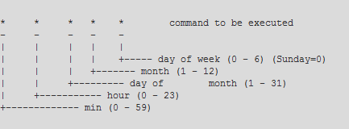

Slide 111
I want to run a backup script to backup /home every saturday at 6:30 PM in the month of January.
30 18 * 1 6 /bin/tar -czvf /opt/backup/homebackup.tar.gz /home
I want to run a backup script to backup /usr monday, wednesday, saturday at 8:30 PM from the months of July through December.
30 20 * 7-12 1,3,6 /bin/tar -czvf /opt/backup/usrbackup.tar.gz /usr
I want you to run a backup script to backup /etc every hour of the day on the 2nd day of any month.
59 * 2 * * /bin/tar -czvf /opt/backup/etcbackup.tar.gz /etc
# The below entry will backup /etc/ every hour on the 2nd day of the month
59 * 2 * * /bin/tar -czvf /opt/backup/etcbackup.tar.gz /etc
# The below entry will email you every 15 minutes with annoying message
*/15 * * * * /bin/mail -s "Annoying email every 15 minutes" ppotluri@vmpro.com < /tmp/emailmessage

Slide 112
Send your self a email or text message every 5 minutes between the hours 1:00 PM - 2:00 PM on the second day of the month
*/5 12-13 2 * * /bin/mail -s "Text Message" 2484444918@vmpro < /tmp/message
Backup /etc or compress /etc file to /opt/backup every 20 minutes between the hours of 8:00 AM - 5:00 PM on the second day of the month and also only on Monday.
*/20 8-17 2 * 1 /bin/tar -czvf /opt/backup/etcbackup.tar /etc

Slide 113
find command by size example:
find -size +10M -exec mv {} largerthan10MB \;
dd if=/dev/zero of=ddfile3 bs=4k count=10000
sambacifs:
yum install samba-client
mkdir /labvideos
mount -t cifs //argos/backup /labvideos
umount /labvideos

Slide 114
SSH KEYGEN and authentication
ssh-keygen –t rsaORdsa<enter>
Enter file in which to save the key: <enter>
password: <enter>
reenter password: <enter>
scp /root/.ssh/id_rsaORdsa.pub
client:/root/.ssh/authorized_keys
ssh client

Slide 115
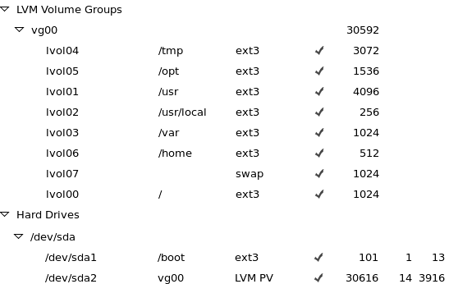
Boot from SAN:-
and configure the LVM at boot using the following image:

Slide 116
HTTPD Install
yum install httpd
vi /var/www/html/index.html → Server name is c1b14lx14
vi /etc/hosts → Add entry for your host
service httpd restart
Open a web browser and access your server by entering your
host name

Slide 117
SUDO
ALL | =(ALL) | ALL
Execute | Execute | Execute
in all | as any | any commands
Terminals | User
useradd dcadmin01
useradd dcadmin02
groupadd datacenteradmins
Add both the users to the group datacenteradmins
Change password for dcadmin**

Slide 118
scp /etc/sudoers YOURSERVER:/etc/sudoers
visudo
Users are represented with their name
Groups are represented with "%" in front of them
dcadmin01 $ sudo wall system shutting down in 30 seconds
&& sleep 30 &&sudo wall `date` &&sudo reboot

Slide 119
For those who are completed with the above lab please create two help desk users and a helpdesk group which allows them to change passwords of any user and create any new user accounts.

Slide 120
export PATH=$PATH:/usr/sbin
Syslogd: Controls which type of log entries end up in log files
Klogd: Captures kernel messages from Syslogd
Logrotated: Controls the size and # of iterations of log files
The entries in /etc/logrotate.conf are used by default if the minsize and rotate are not defined in the
/etc/logrotate.d/syslog

Slide 121
/etc/syslog.conf
/var/log/secure
/var/log/messages
dmesg vs /var/log/dmesg
/etc/logrotate.conf
/etc/logrotate.d/syslog

Slide 122
title CentOS (2.6.18-274.3.1.el5)
root (hd0,0) # Master Boot Device or where /boot is located at
kernel /vmlinuz-2.6.18-274.3.1.el5 ro root=/dev/vg00/lvol00 rhgb quiet # This is the actual kernel line which loads the kernel
initrd /initrd-2.6.18-274.3.1.el5.img # Initialize the RAMDISK, or create a small space in RAM so kernel can go reside there.

Slide 123
SWAP Space:
To create a swap file or extend your system swap use the commands below
dd if=/dev/zero of=swapfilebs=1024k count=2000 # Creates a 2GB swap file
mkswap /tmp/swapfile #Lets the linux know there is a 2GB swap space for your use
swapon /tmp/swapfile # Activates the swap space in the linux kernel
To figure out the process
ps –ef
To figure out the network port
netstat –an
To figure out both
netstat–atnp

Slide 124
SYSCTL (/etc/sysctl.conf)
sysctl –a (Displays all current kernel parameters)
Kernel Tuning for Oracle 11G Enterprise Database for Linux.
kernel.shmall = 2097152
kernel.shmmax = 2147483648
kernel.shmmni = 4096
# semaphores: semmsl, semmns, semopm, semmni
kernel.sem = 250 32000 100 128
net.ipv4.ip_local_port_range = 1024 65000
net.core.rmem_default=4194304
net.core.rmem_max=4194304
net.core.wmem_default=262144
net.core.wmem_max=262144
sysctl –p (Tells the kernel to read the new /etc/sysctl.conf and acknowledges the new changes)
reboot (activates all the new kernel changes at boot)

Slide 125
IPTABLES (LINUX FIREWALL)
iptabes controls or filters network traffic, very similar to your windows firewall.
packet, packet filtering, packet direction.
Traffic (Packets) is determined in three formats:
MAC Address
IP Address
Port No.
Traffic (Packets) can be filter in three formats as well:
Accept
Reject: Notifies the client that the packet was rejected
Drop: Client is notified the packet is dropped so the client will assume there is a network
loss or total silence.
Traffic (Packets) Direction:

Slide 126
INPUT (RX)
FORWARD
OUTPUT (TX)
vi /etc/sysconfig/iptables
serviceiptables start
Sample IPTABLES:
# Generated by iptables-save v1.3.5 on Wed Oct 12 06:55:49 2011
*filter
:INPUT ACCEPT [0:0]
:FORWARD ACCEPT [0:0]
:OUTPUT ACCEPT [198:23220]

Slide 127
:RH-Firewall-1-INPUT - [0:0]
-A INPUT -j RH-Firewall-1-INPUT
-A FORWARD -j RH-Firewall-1-INPUT
-A RH-Firewall-1-INPUT -i lo -j ACCEPT
-A RH-Firewall-1-INPUT -p icmp -m icmp --icmp-type any -j ACCEPT
-A RH-Firewall-1-INPUT -p esp -j ACCEPT
-A RH-Firewall-1-INPUT -p ah -j ACCEPT
-A RH-Firewall-1-INPUT -s 10.40.40.40 -p tcp --dport 80 -j ACCEPT
#-A RH-Firewall-1-OUTPUT -d 10.40.40.40 -p tcp -j ACCEPT
-A RH-Firewall-1-INPUT -d 224.0.0.251 -p udp -m udp --dport 5353 -j ACCEPT
-A RH-Firewall-1-INPUT -p udp -m udp --dport 631 -j ACCEPT
-A RH-Firewall-1-INPUT -p tcp -m tcp --dport 631 -j ACCEPT
-A RH-Firewall-1-INPUT -m state --state RELATED,ESTABLISHED -j ACCEPT
-A RH-Firewall-1-INPUT -p tcp -m state --state NEW -m tcp --dport 22 -j ACCEPT
-A RH-Firewall-1-INPUT -j REJECT --reject-with icmp-host-prohibited
COMMIT

Slide 128
# Completed on Wed Oct 12 06:55:49 2011
Please install Webmin and get webmin to work on your browser for all users.
Verify whether firewall is up and running: service iptables status
Verify rules of firewall: service iptables status
iptables -l
Turn off firewall: service iptables stop
Turn on firewall: service iptables start
Restart firewall: service iptables restart

Slide 129
TCPDUMP
TCPDUMP dumps TCP Packet information based on interval and/or a certain port, you can use the dump and import it in to Wireshark which will let you analyze the TCP Packet Data. So you can see when the packet was either sent or received, what type of packet and what is inside the packet.
tcpdump -vvs 65535 -w /tmp/tcpdump.pcap
press ctrl+c if the above command does not stop after 2 minutes.
Download Filezilla client on your view machine
sftp to your host using filezilla, browse to /tmp and copy and paste the tcpdump.pcap on to your view machine.
Download Wireshark its free on your view machine.
In Wireshark click on file --> open --> select the tcpdump.pcap

Slide 130
Vgdisplay: command output
VG Name vg10
VG Name: Volume Group Name
System ID
System ID: If the VG is being shared you would have a defined System ID for ex:
GFS (Global File System)
Format lvm2
Format: Since the VG is based out of LVM family, and lvm family is divided in to
lvm and lvm2 we are using the latest version of lvm which is lvm2.
Metadata Areas 1
Metadata: This is an area used for iNodes to avoid Double writes.
Metadata Sequence No 1
Read Above related to Metadata

Slide 131
VG Access read/write
VG Access: Can you read only or can you read and write.
VG Status resizable
VG Status: It defines whether you can add more PVs to the current VG if it is not
resizable only the PVs used during the VG creation get used
MAX LV 0
Cur LV 0
Open LV 0
Max PV 0
The above underlined are predefined set rules to prevent admins from creating
more than set limit LVs.

Slide 132
Cur PV 1
Act PV 1
The PV defines how many PVs or Partitions are residing inside the VG. Current means how many added to the VG and Active means how many are being used by the VG.
VG Size 10.00 GB
The size of all the PVs put together defines the VG size
PE Size 4.00 MB
Physical Extent size which describes the smallest Logical Volume you can create, so in the value above that means you can create Logical Volume with as little as 4MB in size.
Total PE 2559
VG Size = PE Size X Total PE
Alloc PE / Size 0 / 0
Alloc PE = How many PEs are currently in use or allocated
Free PE / Size 2559 / 10.00 GB
Free PE = How many PEs are still available for you to create a LV.
VG UUID fmc7Bj-2Y2A-tYEd-XldU-9UAL-2SeE-kgUOP2
VG UUID = Kernel refers to this UUID as the Volume Group, VG Name variable above is just
for you to understand or to make it easily human readable.

Slide 133
E2label
e2label /dev/mapper/T2_LXLUN02p1 T2_LXLUN02
entry in /etc/fstab: LABEL=T2_LXLUN02 /emclun ext3 defaults 0 0
SWAP Entry in /etc/fstab:
/emclun/ddfile1 swap swap defaults 0 0

Slide 134
Tunnel X sessions or X based application on to your desktop:
yum install firefox
install xming from \\argos\labvideos on your vmware view machine
make sure xming is not running, open xlaunch or search for xlaunch on your windows machine.
click next, next, select or check no access control
on your linux machine run "export DISPLAY=YOUR_VMWARE_VIEW_MACHINE_IP:0.0"
firefox

Slide 135
SUDO Scenario: You have over 2000 servers in a datacenter and you need to provide your data center admins the ability to shutdown the server so that they can perform maintenance at 3 A.M. without distrubing you or other system administrators.
Create a Data Center Group Admins
groupadd dcadmin
Create users called Prasad and Asif and add them to the Data Center Admins Group.
useradd -g dcadmin Prasad
useradd -g dcadmin Asif
passwd Prasad/Asif

Slide 136
visudo and add permissions for the Data Center Admins Group to execute shutdown command as root.
visudo, and Setup Cmnd_Alias (is like a variable which holds values/commands that other users can run)
or Add the below entries in visudo:
Cmnd_Alias SHUTDOWN = /sbin/shutdown, /sbin/init
%dcadmin ALL=(root) NOPASSWD: SHUTDOWN
Provide access to the Cmnd_Alias with the dcadmin group
Login as Prasad/Asif and Test sudo.

Slide 137
Private Yum Repository:
NFS mount e3b3lx35:/mnt/centos5.7/media to /mnt folder.
mount e3b3lx35:/mnt/centos5.7/media /mnt
remove all files in /etc/yum.repos.d
rm -rf /etc/yum.repos.d/*
yum install xclock
create a new file with a extension of .repo under /etc/yum.repos.d and add the below information:

Slide 138
[CentOS5.7] ### This the section or the category that print when you run yum list
name=CentOS5.7 ## This is name of the repository
baseurl=file:///mnt ### This is the location where the media is stored
enabled=1 ### 0 = no and 1 = yes
gpgcheck=0 ### if you are a strict organization this is required it performs a GNU Privacy Guard check.
yum install xclock
:wq /etc/yum.repos.d/FILENAME.repo
To verify selinux
getenforce
to disable selinux modify /etc/selinux/config and change the enforced to disabled and reboot.

